Slide 1
PROGRAMMING TECHNIQUES: LOOPING, COUNTING AND INDEXING

Slide 2
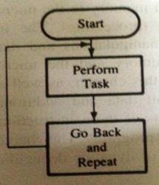
LOOPING, COUNTING AND INDEXING
Continuous loop-repeat task continuously
Conditional loop-repeats a task until certain data conditions are met.
Flowchart of continuous loop

Slide 3
LOOPING, COUNTING AND INDEXING
Looping-In this technique, the program is instructed to execute certain set of instructions repeatedly to execute a particular task number of times.
Counting-This technique allows programmer to count how many times the instruction/set of instructions are executed.
Indexing-This technique allows programmer to point or refer the data stored in sequential memory location one by one.

Slide 4
Generalized programming flowchart
Start
Decision Making. Are all operations complete?
Yes
Initialization
Data Acquisition
Output
Data Processing
Temporary storage of partial results
Stop
Getting ready for
next operation

Slide 5
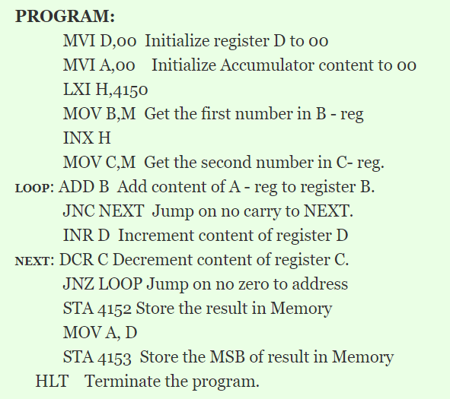
Multiplication OF TWO 8-BIT NUMBERS

